Slide 1

How can dance continue to be engaging for younger / new audiences?

Slide 2
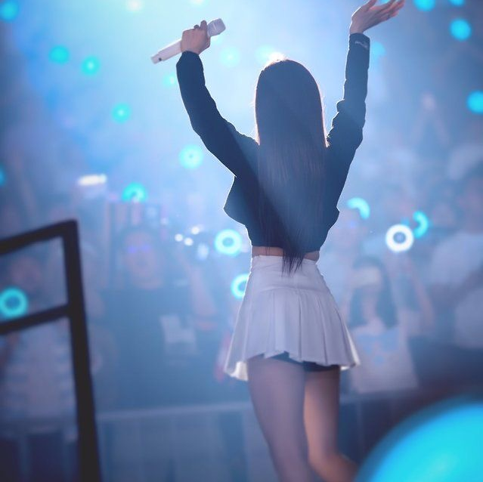
Introduction
In this blog, I’ll be discussing 2 works performed by k-pop groups. K-pop is a music genre that is becoming very popular among young people. Some examples of popular groups are BTS and Blackpink who have music videos with over 1 billion views.
Many of the songs in this genre also have choreographies. A lot of fans like to learn these dances and share them on social media.
This can inspire other to learn them too. There is a variety of easy and harder dances, making it appealing for beginners as well.

Slide 3
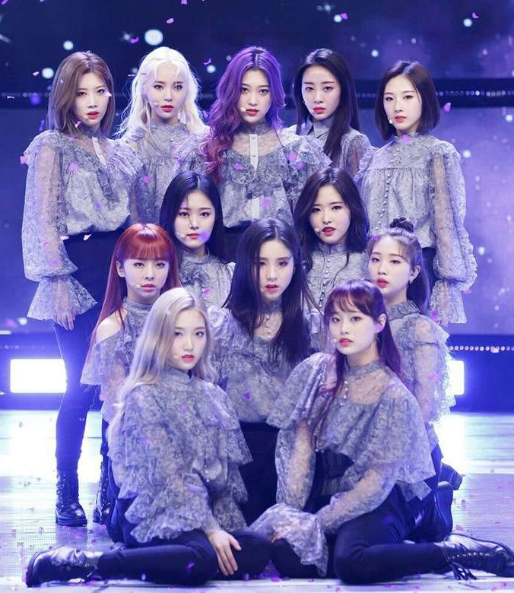
Butterfly - Loona
‘Butterfly’ is a graceful and whimsical dance. The song represents following your dreams and overcoming obstacles in your life, just like the journey from a caterpillar to a butterfly. This can be seen in the dance when the members start off on the ground before reaching up, almost marking the start of a journey. Throughout the dance, there are movements which mimic the action of a butterfly (ie the fluttering of its wings).
The actual choreography within the dance is very intricate. I enjoy their elegant transitions between movements. Loona are also very well-known for their synchronisation with each other.
Dance practice: https://youtu.be/ADJorSdTRCI
Music video: https://youtu.be/XEOCbFJjRw0

Slide 4
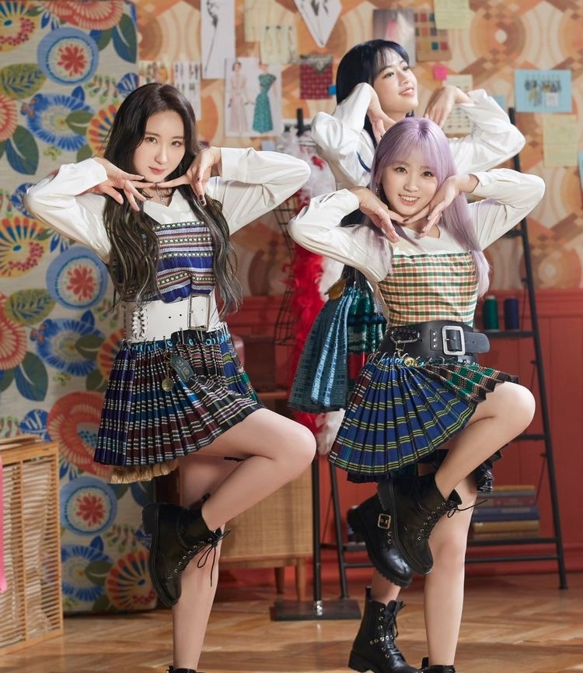
Fiesta – IZ*ONE
Another dance I really like is ‘Fiesta’ by IZ*ONE. The song is bright and cheerful which is reflected in the dance. ‘Fiesta’ means ‘party’ in Spanish hence the lively movements. There are a lot of detailed moves, especially the part after the first chorus. Like Loona, IZ*ONE also have very good synchronisation.
One 13 year old said, “I enjoy the contrast between faster and slower movements”.
An adult said, “They’re great performers and they have good facial expressions.”
Dance practice: https://youtu.be/kCk8x__pXvE
Music video: https://youtu.be/eDEFolvLn0A

Slide 5
Thank you for reading!

